Slide 1
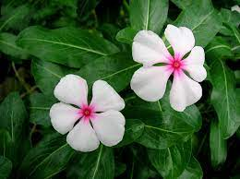
Ethnobotany
By:
Dr. Kiran Jain
Ph.D in Botany
Govt. Digvijay PG autonomous college
Rajnandgaon
(Dept. of Botany)

Slide 2
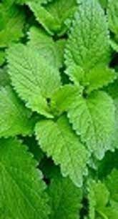
Introduction:
The term Ethnobotany was 1st used by botanist named John.W.Harshbeyger in 1896.
Ethno in Ethnobotany means – Study of Culture.
Botany means – study of plants.
Basically Ethno botany is the study of relationship that exist between plants and people.
Aim is to documents, describe, and explain complex relationship between cultures and uses of plants.
Ethnobotany is linked to Taxonomy, Nutrition, Pharmacognosy, Phytochemistry, Ecology, Biology.

Slide 3
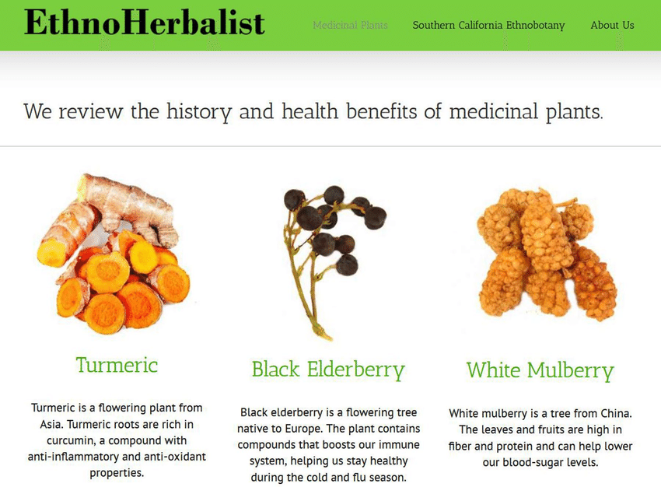

Slide 4

Ethnobotany as a career:-
In university Community, Govt; international agencies or non govt; Organization. Ethnobotany studies can be conducted as Botanical, Archaeological, ; Computer Laboratory or in herbarium.
Required fieldworks in the outdoors : methods include :- note taking, Statistics, Collecting and Preparing plant specimen, microscope work analysis of nutrient and plants Chemicals . Genetic studies and ecological survey work.

Slide 5
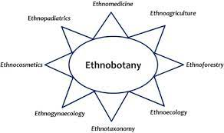
SCOPE OF ETHNOBOTANY
The scope of ethnobotany in recent time and failure has been established with the problem. Rural health, Drugs and Abuses, Social customs.
Ethnomedecine
Ethnopharmacology
Ethnoveterinary
Ethno-narcotics
Ethnocosmetics.

Slide 6
Plant Substance as a technical products
Commercial/Industrial uses | Natural substance as technical Products
In Perfumes | Lavender, sandalwood, citronella, Myrhh & Balsam of tolu
In soaps | Fatty acids from castor oils, clove oil, peanut oil
In shampoo | Quillaia, Reetha, Hibiscus.
In hair dressings | Coconut oil, castor oil, henna
In bakery | Acacia, agar, alginates, stwerculia gum
In cigrettes, cigars, snuffs | Glycyrrhiza, Vanilla
In textiles | Cotton, Catechu rosin.

Slide 7
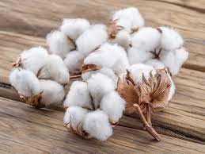
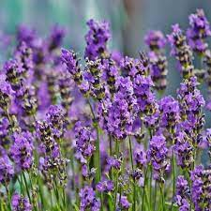
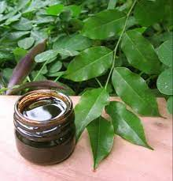
COTTON
Lavender
BALSAM OF TOLU LAVENDER PERFUME

Slide 8
Local Name | Botanical name | Family | Usable part
1.Chirayata | Swertia.chirata | Gentianaceae | Whole plants mainly leaves.
2.Shatavar | Asparagus racemosus | Liliaceae | Tuber root
3.Bathua | Chenopodium.album | Chenopodiaceae | Leaf or seeds
4.Ginger | Zingiber.officinale | Zingeberacea | Rhizomes
5.Kalmegh (Kirata) | Androgaphis.paniculata | Acanthaceae | Leaves of entire aerial portion
6. Brahmi | Centella.asiatica | Umbelliferaceae | Fresh or dried herb
7.Aaswagandha | Withania.somniferum | Solanaceae | Dried roots and stem

Slide 9
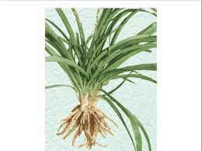
1. Safed Museli :
Biological sources | This consist of dried peeled Tuberous Root of the plant known as Chlorophyllum borivillianum. Family: Liliaceae.
Chemical constituents | Carbohydrates 39 to 43.0%; Protiens 8-12%; Saponins 2-4%; Sapogenin 0.18 to 0.2%.
Uses | Tonic for debility, Used as a gym energy food .

Slide 10
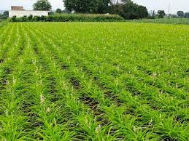
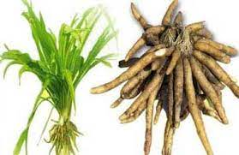
Morphological structure :
Colour : white
Odour : slight Characterstics
Size : 2-4 cm
Shape : Elongated and tapering.
Museli and its cultivation

Slide 11
Geographical Sources : found in Africa and also India. Now a days it is scientifically cultivated in commercial scale in MP Maharashtra southern Rajasthan and North Gujraat .
Cultivation and collection : It’s a 210-240 days Crop.
Soil : Red Loamy graverly and drained soil.
Soil p H -6-7
Required rainfull : 52-75 cm.
No Pesticide is required . Chlorosis may occure due to Iron deficiency.
Seeds or roots are sowed in early July or June in 15*15 cm distance . Irrigation is done in the interval of 10-15 days .
Collection : after first week of February tuber roots are uprooted by digging method and put them in shade for 8 days.

Slide 12
Tulsi
SYNONYM : Sacred basil.
REGIONAL NAMES : San. Hin and Beng. Tulsi
The drug consists of the leaves of Ocimum sanctum , Family: Labiatae
It is an annual herb with much branched stem having verticillaster inflorescence. Flowers are purple in racemes
Trichomes are present on both the surfaces of the leaves and they are minutely gland dotted.
CONSTITUENTS : The whole herb is Volatile oil 0.4-0.8%, eugenol 70% (main),Methyleugenol, Carvacrol 3%, and Caryophylin (1%).
Uses : Antibacterial, insecticidal, antiprotozoal, diaphorectic and expectorant protiens, leaves also used as Aromatic Carminitive.

Slide 13
COFFEE:
SYNONYMS : Coffee beans, Coffee seed.
It is the dried ripe seed of Coffea arabica Linne or C.liberica Hiern, and deprived of most of the seed coat . Family : Rubiaceae.
Geographical sources : Ethiopia, Brazil, India, Vietnam, Mexico, Guatemala, Indonesia, and Srilanka. In middle east country it is known by name ‘Qahuah’.
The separated seeds or beans are green in colour. They are roasted by which the colour and odour is effected. The seeds acquire dark brown colour and possessan agreeable odour.
Chemical Constituents : The main Constituents of coffee bean are caffeine, tannins, fixed oil and protiens. 2-3% tannins, 13% protiens, 10-15% fixed oils, chlorogenic or caffeotannic acid and sugars in the form of dextrins, glucose etc.
Uses : source of Caffeine, stimulant and diuretic action are due to caffeine also use to combat the toxic effects due to CNS depressants

Slide 14
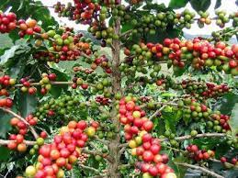
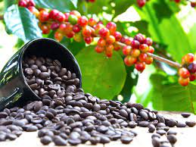
Coffee plant
Coffee roasted

Slide 15
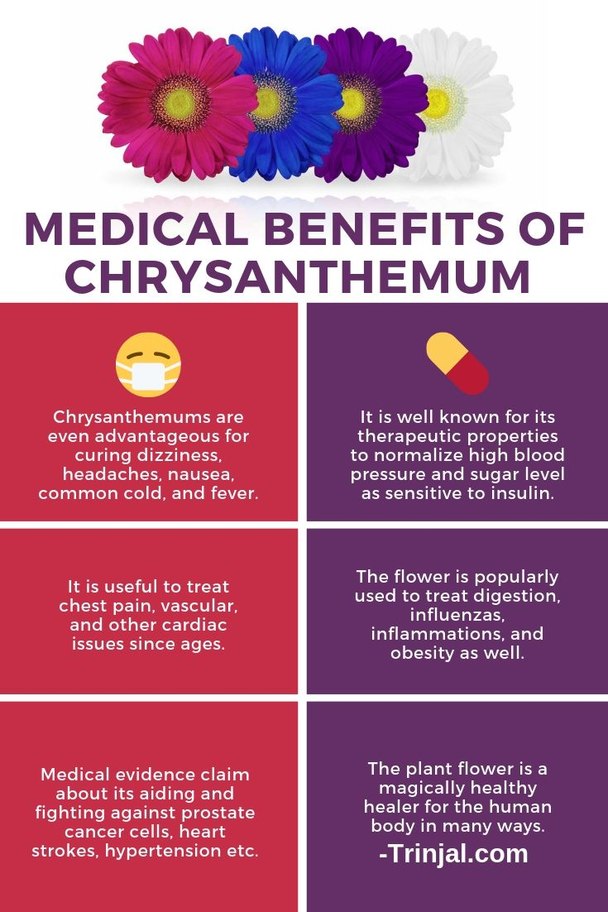
Sewanti
Chrysanthemum is used to treat chest pain (angina), high blood pressure, type 2 diabetes, fever, cold, headache, dizziness, and swelling.
In combination with other herbs, chrysanthemum is also used to treat prostate cancer.

Slide 16
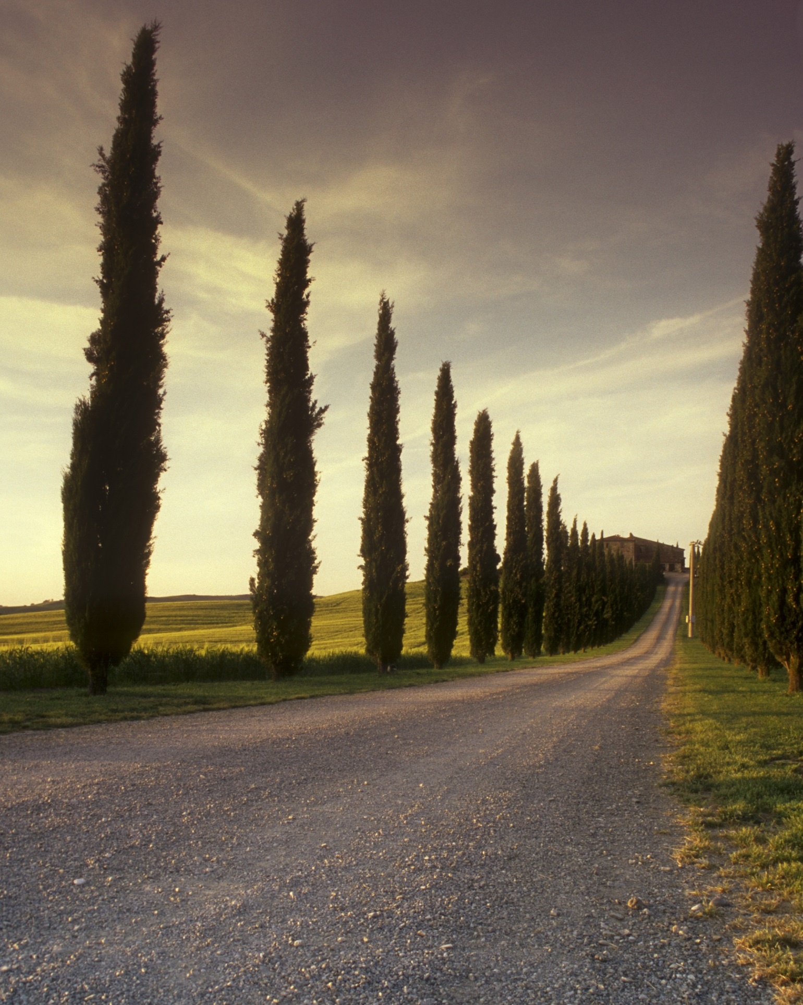
Referenes :
1.From C.K kokate “Pharmacognosy” book .
2.Journal of ethnobiology and ethnomedicine
3. Journal of ethnopharmacology
Dr. Kiran Jain
D.M.V. BOTANY DEPARTMENT RJG
THANK YOU

